Slide 1

Drug Disco
Drug Discovery:
Labeling Mechanism of
Action w/ Gene and Cell Assays
Kris Cowie
Notes:
Hey everyone, my name is Kris Cowie
We’re going to be talking today about using neural networks to label novel chemicals mechanism of action

Slide 2
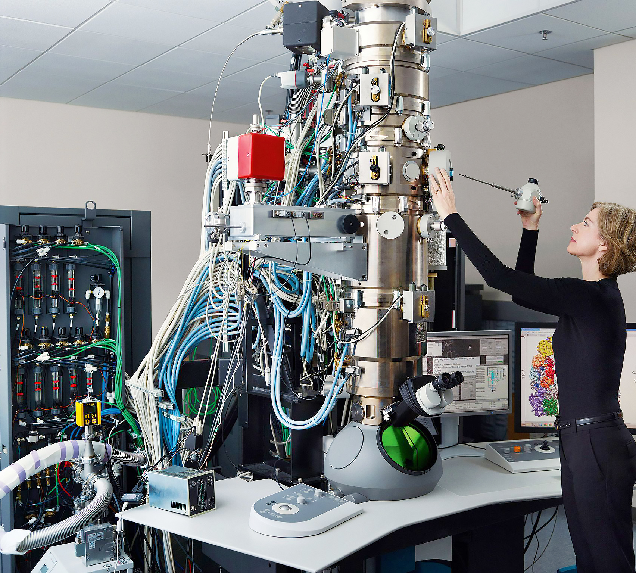
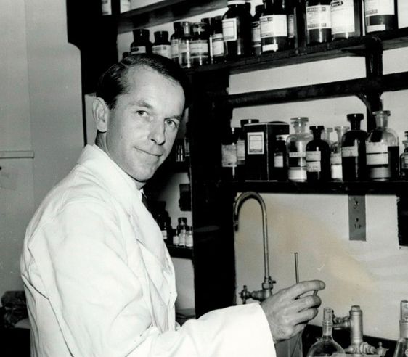
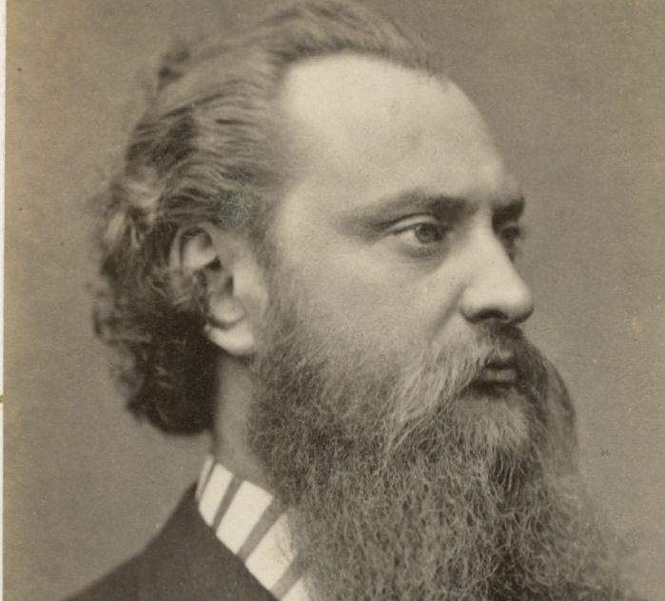
Drug Discovery
Historical – isolation and synthesis of active compounds in traditional remedies
Rational: 60s, start with the end in mind
Current – high throughput assays, genetic sequencing, large chemical libraries
Notes:
Historically, drugs were developed through isolation and synthesis of active compounds from traditional remedies, or through serendipitous discoveries (i.e. penicillin)
Rational drug design started in the 60s, and that’s where you start with the end target in mind, and develop molecules around their expected interactions
Kind of like if you wanted to make a new disco song, you’d start with a four on the floor beat, syncopated bassline, string section, electric piano, etc.
With current technology, it’s kind of like having a recording suite, with a large library of samples and auto tune and things you can do to tweak the libraries of samples you have to the desired effect

Slide 3


Discovery / Development
Targeting
Select a naturally occurring cellular or molecular structure
Connected with the pathology you’re addressing
Screening
- Large chemical libraries tested on human cells
- Screening identifies the mechanism of action (inhibition or activation)
- As well as which genes / receptors are activated
- Cell toxicity also tested
Notes:
We’re going to just be looking at the first step in the drug pipeline, the discovery / development stage
Initially, you’ll usually select a target cellular or molecular structure associated with whatever you want to address (think the spike proteins of coronavirus)
After that, you’ll test large libraries of chemicals on batches of human cells
Using gene assays, you can identify the ability of the molecules to either inhibit or stimulate receptors (antagonists, and agonists)
These also identify which receptors you’re activating or inhibiting
Cell assays test for toxicity of the chemical

Slide 4
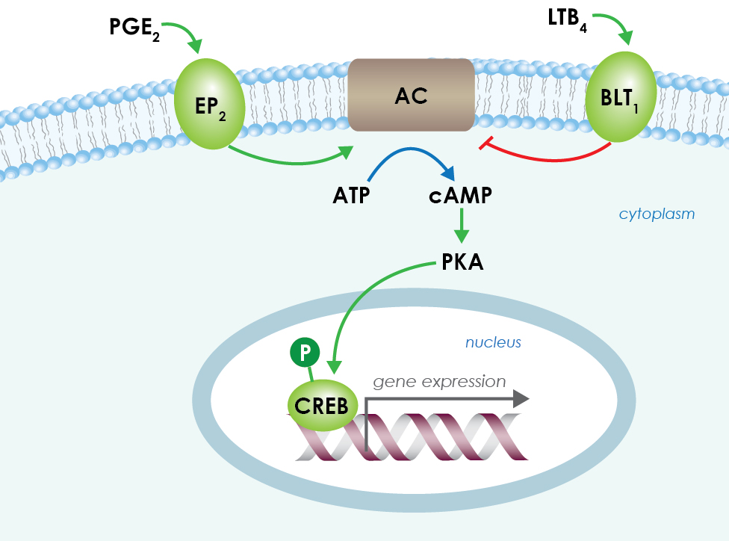





Mechanism of Action (MoA)
- Dataset is novel in that it combines gene expression and cell viability
- Tests 100 different types of human cells
Tests expression of 772 genes
206 possible classes of drugs (some are multi-labelled
One of the stumbling blocks for many drugs is their toxicity
Testing cell viability at the same time should identify this earlier
Notes:
We’re going to be looking at the Mechanism of Action
The dataset we’re using is a novel and awesome one from NIH and Harvard, where they test chem libraries on batches of 100 different human cells at a time, along with 772 genes
Removes the problem of trying to figure out which cells to try and target, along with which genes to try and target, because you’ve got a 100 different human cells, and a ton of potential gene pathways.
For those that don’t know how gene expression and MoA work, let’s use another music metaphor
Think of the entire pathway as the dance floor from Saturday Night Fever, and the gene we’re interacting with as Stephanie (CREB in this example)
If we want to stimulate or activate that gene along that pathway (the dance floor), we’d introduce John Travolta (PGE2). The molecule then stimulates the expression of that gene
If we wanted to inhibit that expression, we’d introduce an antagonist – Double J in this example. He stops the expression.
Sometimes though, drugs can interact with multiple pathways and genes – so maybe John Travolta activates Annette as well, another gene along another pathway
So this makes it a multi-label problem – drugs can be two or more different things at the same time

Slide 5
Exploring The Data
Data had been preprocessed prior to release, with both quantile normalization, and differential expression
There are four features outside of the gene and cell assays:
Treatment / Control – small number of samples treated with control
Dosage – two different dose levels
Timing – elapsed time between dose and measurement
Label – what we’re actually looking to label the drug as
The training dataset contains a second dataset which indicates what class of drug the chemical is
Sig_id | Cp_type | Cp_time | Cp_dose | g-0 | g-1 | g-2 | g-3 | g-4 | g-5 | ... | c-90 | c-91 | c-92 | c-93 | c-94 | c-95 | c-96 | c-97 | c-98 | c-99
id_0004d9e33 | trt_cp | 24 | D1 | -0.5458 | 0.1306 | -0.5135 | 0.4408 | 1.55 | -0.1644 | ... | 0.0981 | 0.7978 | -0.143 | -0.2067 | -0.2303 | -0.1193 | 0.021 | -0.0502 | 0.151 | -0.775
id_001897cda | trt_cp | 72 | D1 | -0.1829 | 0.232 | 1.208 | -0.4522 | -0.3652 | -0.3319 | ... | -0.119 | -0.1852 | -1.031 | -1.367 | -0.369 | -0.5382 | 0.0359 | -0.4764 | -1.381 | -0.73
id_002429b5b | ctl_vehicle | 24 | D1 | 0.1852 | -0.1404 | -0.3911 | 0.131 | -1.438 | 0.2455 | ... | -0.2261 | 0.337 | -1.384 | 0.8604 | -1.953 | -1.014 | 0.8662 | 1.016 | 0.4924 | -0.1942
Notes:
Here’s a quick look at the data
One hot encode the cp time and dose, remove control vehicles
Data very tabular

Slide 6
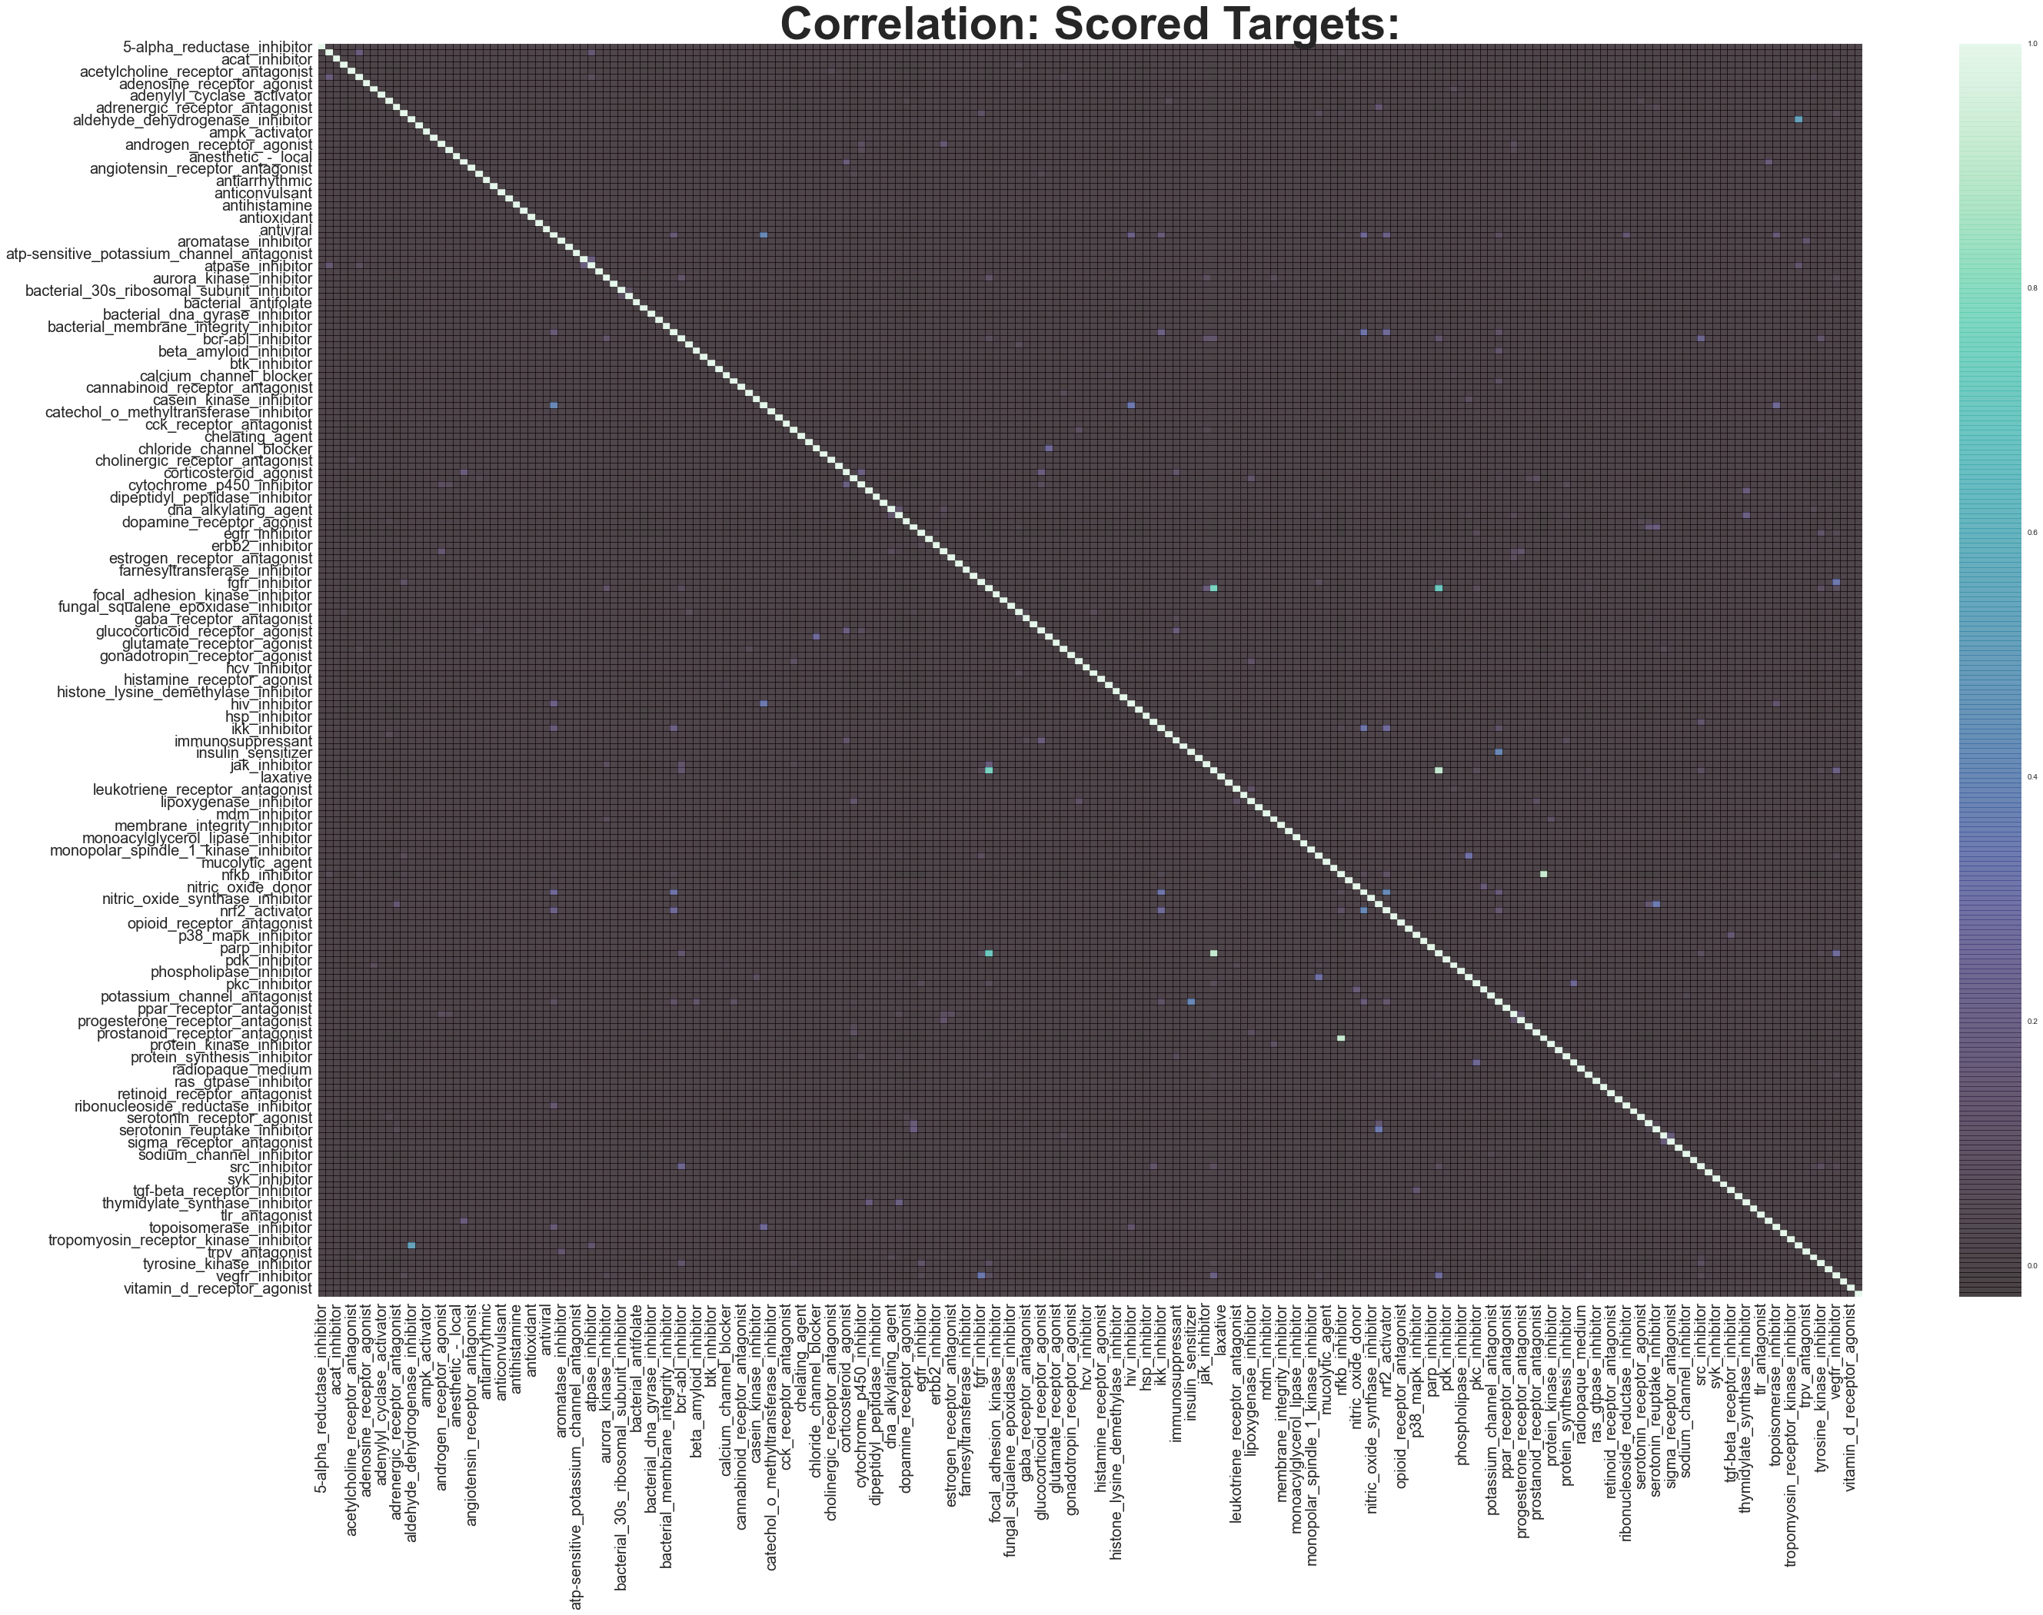
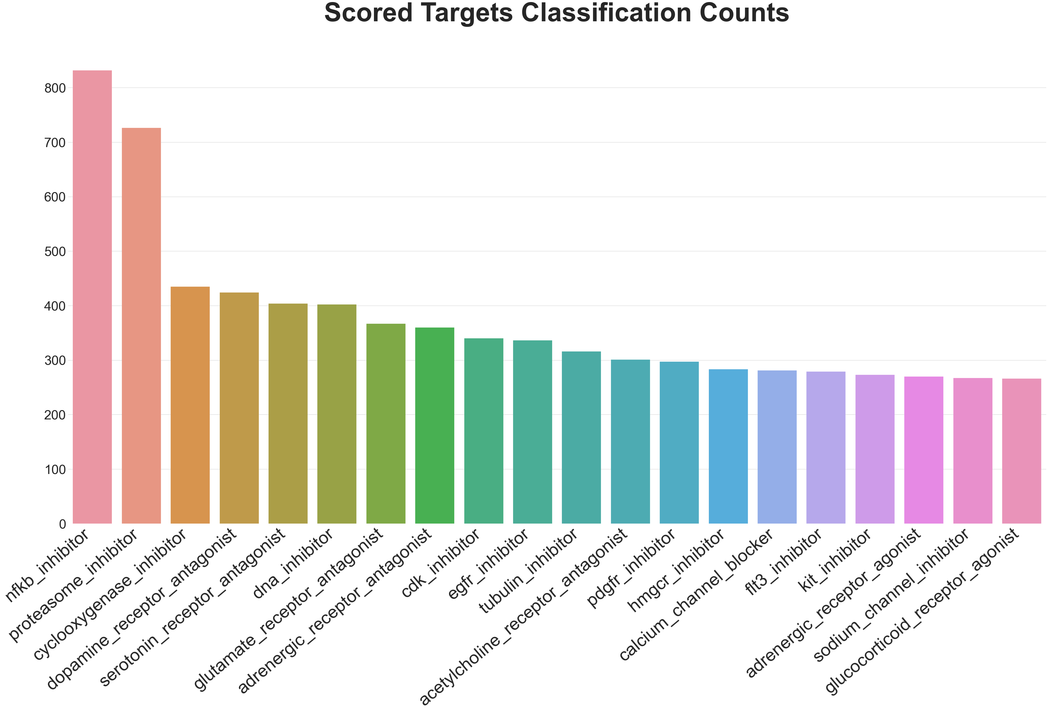
Exploring The Data
Top 20 most common labels in the dataset
Notes:
The most common drugs cover your usual suspects like DNA and RNA inhibitors (your NFKB, Tubulin, and Proteasome inhibitors)
Pain killers like opioid agonists, and cyclooxygenase inhibitors
And mood alters like serotonin, dopamine, norepinephrine, and Glutamate antagonists

Slide 7
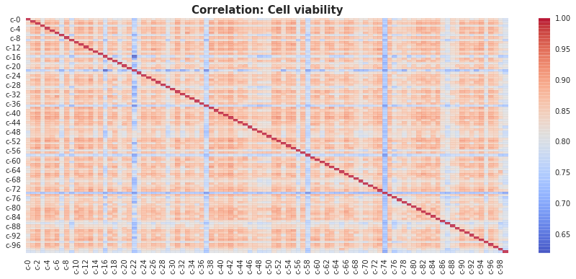
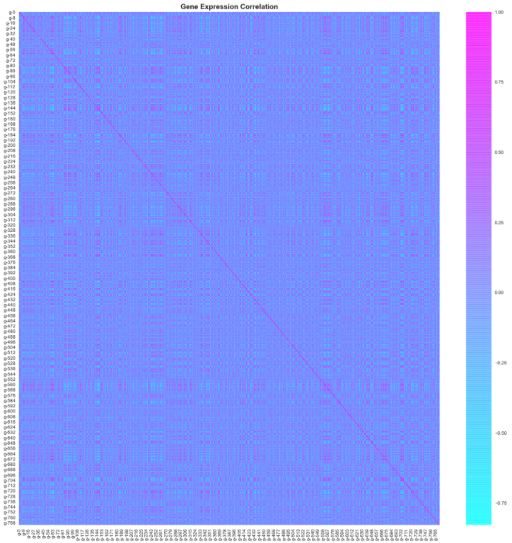
Engineering the Data
Cell Viability Correlation
Gene Expression Correlation
Correlation Heatmaps
Show us there’s strong correlation between cell’s viability
As well as identifying some gene’s which are strongly correlated with each other
We can use this information to engineer combinatorial features like multi gene and
Notes:
Here’s some cell viability and gene expression correlations, several genes and cells are highly correlated
I used this data to engineer about 40 new features by averaging the highest correlated cells and genes together, along with some standard mean, sum, kurtosis, skew features

Slide 8
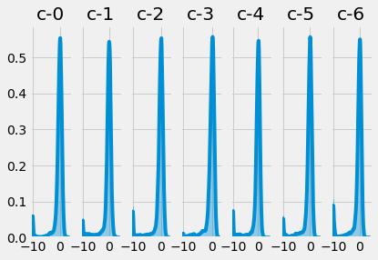
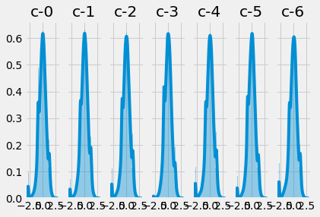
Preprocessing
Applied both Rank Gauss, and PCA prior to training
Helped to normalize data
Which, in turn, helps with neural network training
Notes:
Applied both Rank Gauss (a new type of normalization that helps with transforming to gaussian distribution), and PCA prior to training
Helped to normalize data

Slide 9
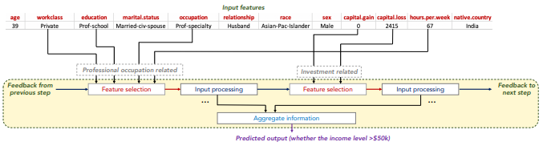
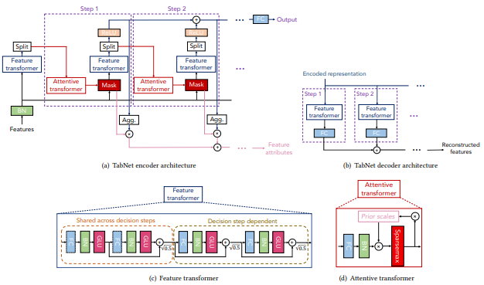
Modeling - TabNet
Classical neural networks work well with data with many features, that might not be tabular initially
Machine learning algorithms works great for tabular data, and less features
Enter: TabNet
New neural network architecture from Google researchers
Great for tabular data
Notes:
Tabnet uses sparse feature selection to enable interpretability and better learning capacity, as it’s used for the most salient features
Employs multiple decision blocks that focus on processing a subset of input features for reasoning
Wanted to use a neural network architecture I hadn’t before, and this one seemed both promising, and generally applicable to a wide range of other problems – the example used in the paper was census income prediction, poker hand induction, store sales data, and a Higgs Boson dataset (it outperformed XGBoost, LightGBM, and Gradient Boosted Tree algo’s).
If you want to know more, I’d be happy to talk about it in a breakout room, but generally it’s been found to be super powerful and outperforms standard ML algos

Slide 10
Training - TabNet
Drug Id | Drug Label | Confidence
id_0822fc188 | hsp_inhibitor | 0.99972695
id_07d981850 | proteasome_inhibitor | 0.9937968
 | nfkb_inhibitor | 0.98721063
id_018c5b9b7 | cdk_inhibitor | 0.9790454
id_06a60d4fa | dna_inhibitor | 0.24755485
id_055448d77 | egfr_inhibitor | 0.92779464
id_04b3fec95 | hdac_inhibitor | 0.91980636
id_03b733bd6 | vegfr_inhibitor | 0.26993713
id_035606e53 | tgf-beta_receptor_inhibitor | 0.8789313
 | alk_inhibitor | 0.3641437
 | gamma_secretase_inhibitor | 0.26930365
id_030bc9cfa | hmgcr_inhibitor | 0.64416176
id_022f34dc4 | dna_inhibitor | 0.11644321
id_02072e865 | proteasome_inhibitor | 0.9843784
 | nfkb_inhibitor | 0.9708481
id_6f5e15fe6 | tgf-beta_receptor_inhibitor | 0.6570596
id_6f5e15fe6 | alk_inhibitor | 0.34303913
id_6f7932969 | topoisomerase_inhibitor | 0.65674645
id_6ff704112 | mtor_inhibitor | 0.74578285
 | pi3k_inhibitor | 0.68304753
id_703654423 | hdac_inhibitor | 0.97919786
id_703c36be0 | adrenergic_receptor_agonist | 0.34125698
id_7048b93d8 | egfr_inhibitor | 0.9909614
id_70a7b102d | mdm_inhibitor | 0.14999908
id_70ca90e6b | raf_inhibitor | 0.9992136
id_71ec39916 | egfr_inhibitor | 0.962814
id_7271eea4a | mtor_inhibitor | 0.6727682
 | pi3k_inhibitor | 0.10857824
Using 10 MultiLabel Stratified Kfolds with a max of 200 epochs per fold
Benefits of TabNet
Quick
Efficient
Powerful
Interpretable
Results after training
Notes:
Tabnet turned out to not only be a powerful neural network architecture for this problem, but it also proved fairly rapid, somewhere around 5-6 minutes per fold, for 10 folds (about 50-60 minutes of training time using Google Colab’s GPU environment
It’s a little more interpretable than a normal DNN
TabNet has a Pytorch implementation available, so used that
After training you end up with something like the table here – each drug id from the test set has it’s predicted label, confidence, and in some cases it’s given multiple labels to the drugs

Slide 11
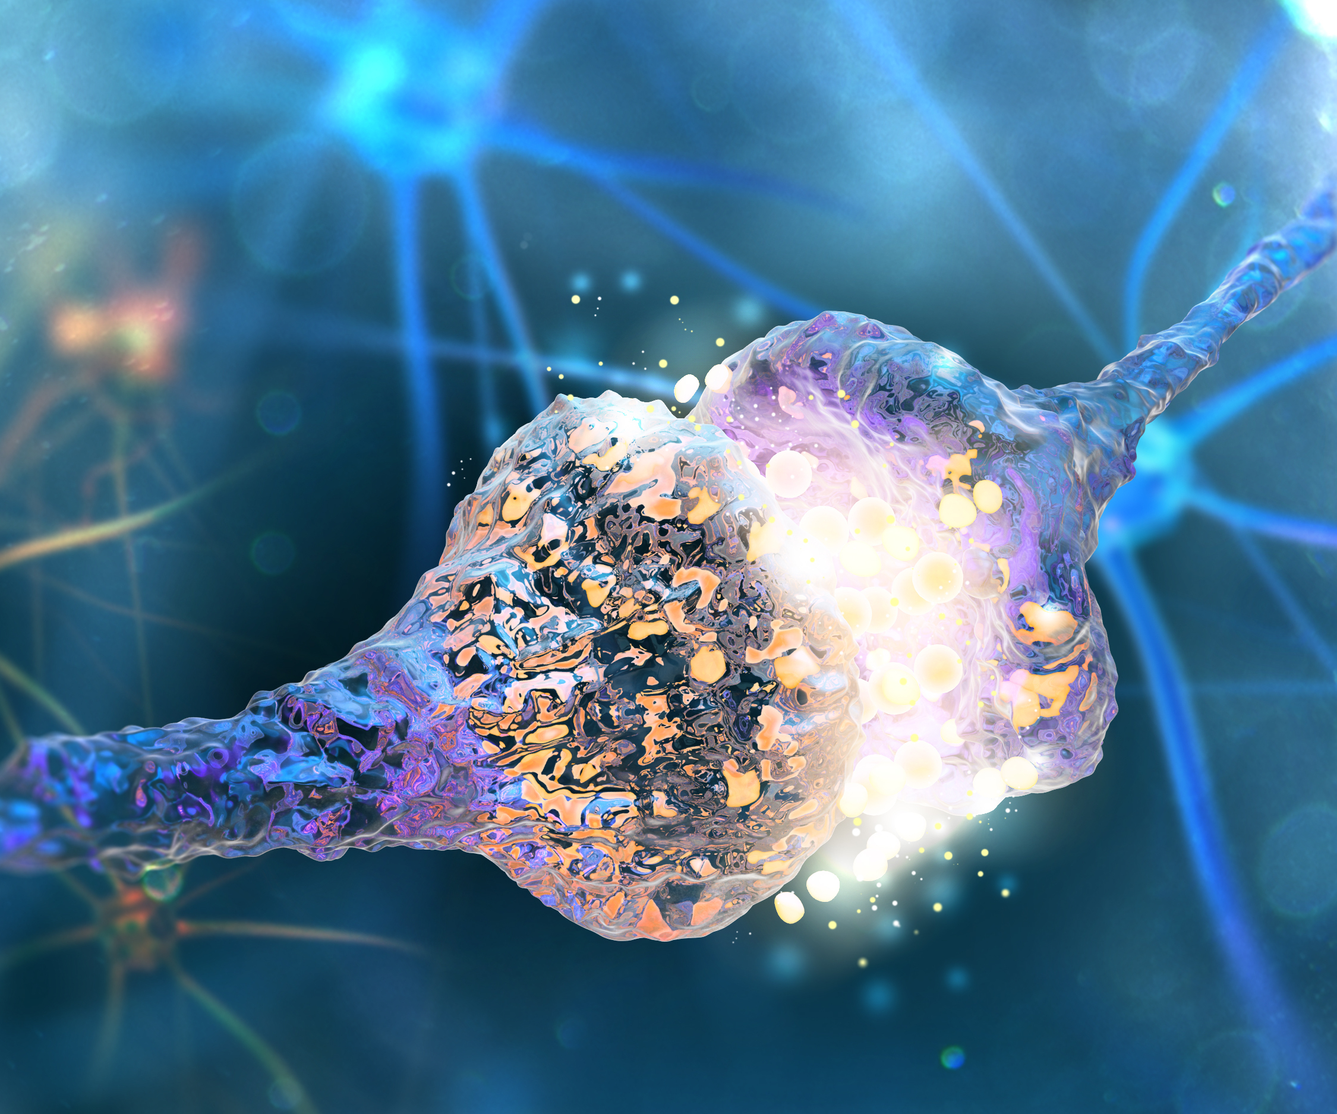
Next Steps
Future versions could be trained on much wider chemical libraries (there were a fair number of classes of drugs which only had a couple samples each)
Deploying should wait until preprocess schema released
Once preprocessing schema is released can combine that with the existing script to automate the process
TabNet is quick and easy to implement, with fantastic results, which can be readily applied to a wide range of problems
Robust results
Generalizable to a ton of problems – it beats XGBoost, LightGBM, and CatBoost in their own domains, by significant amounts, while not being too much more computationally expensive
Potential is endless – cancer research, better painkillers, anti-depressants, etc
Notes:
Could use this to quickly identify unique protein structures on cancer cells, then use these high throughput assays and neural networks to identify chemicals that specifically interact with only those protein structures, and have inverse cell viability (meaning they quickly kill off that cancer cell).
In addition, the actual architecture for TabNet is fairly easy to implement, and gives strong results, with limited resources
Or in any other field like sales prediction, income prediction, what have you
It has options for both classifier or regressor, so can be used for both problems.

